Slide 1
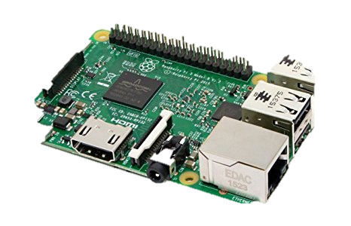
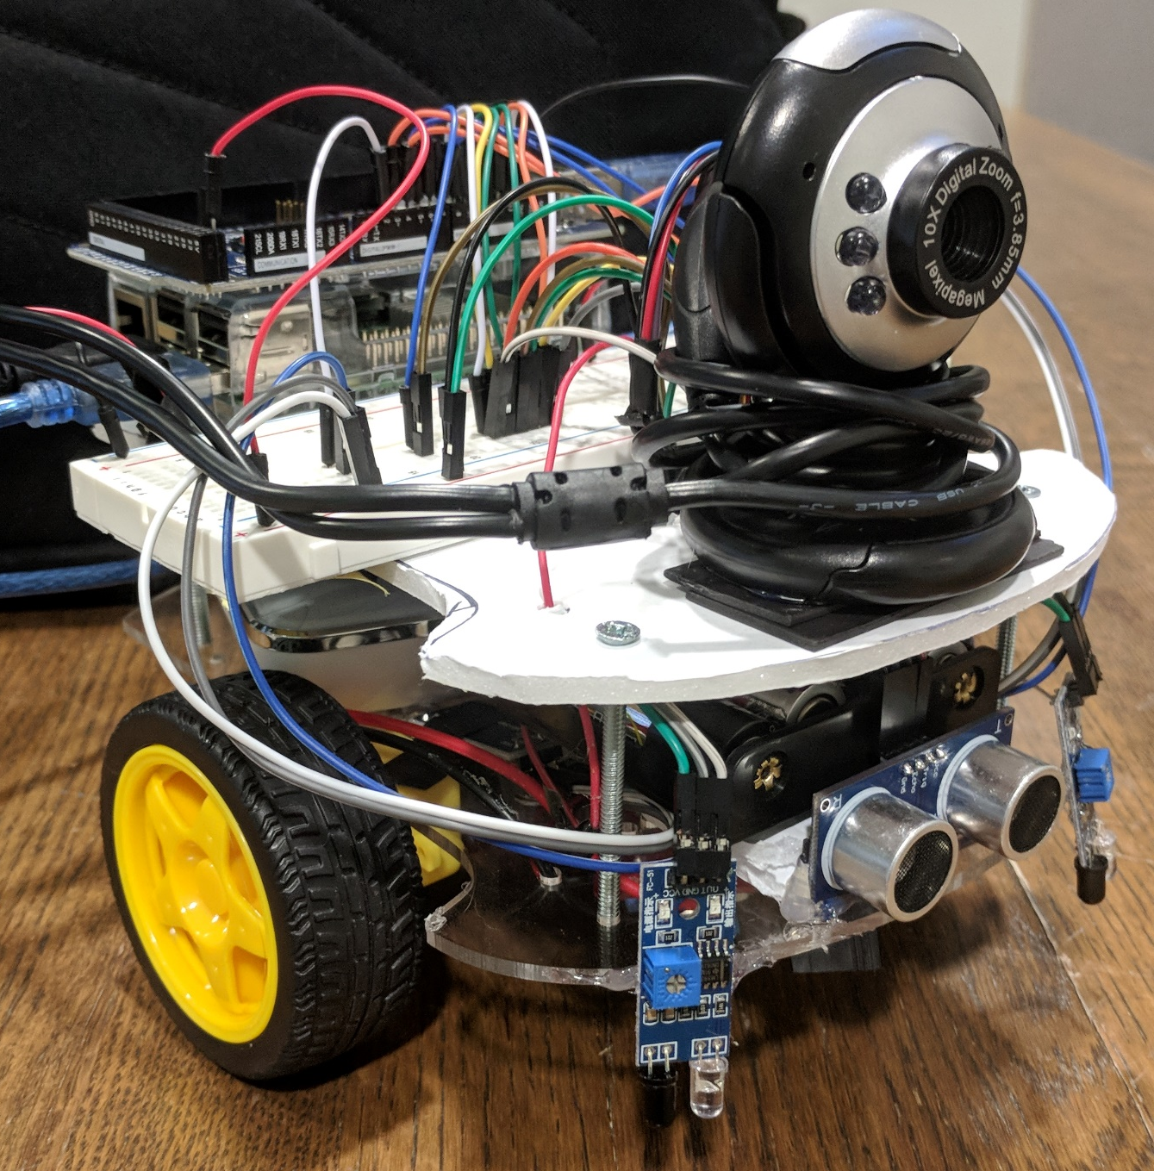
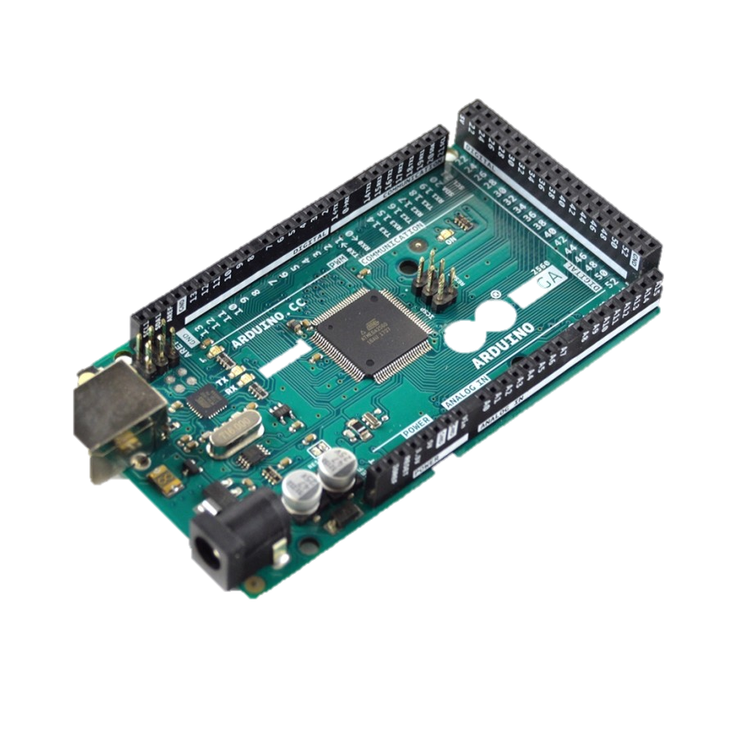
Simple Unmanned Ground Vehicle
Description
Vehicles typically require a live operator. With a SUGV, this requirement is no longer necessary. Making the vehicle autonomous also negates the need for a remote operator. A live video feed allows a user to see the vehicle surroundings in real-time.
Goal
The goal of this project is to create a fully autonomous mobile robot inspired by the functionality of a car. It should detect lines and obstacles interrupting its path. It should also have an option for manual control.
Approach
Build a basic car structure with wheels to emulate a car
Using a Raspberry Pi and Arduino board, give the vehicle the ability to process information in real-time
Attach sensors for line and obstacle detection, along with a camera for video feed
Program the sensors to gather information and calculate motion planning
Test the vehicle on a specialized track
Milestones
Hardware
Setup Pi Environment
Assemble Robot
Software
Develop algorithm for sonar & line sensors
Develop algorithm for motor controls
Implement protocol for user input & real-time response from robot
Date
3/17
3/14
3/21
3/28
4/2
Andrew Gast
April 4, 2018

